Slide 1

ARTIFICIAL INTELLIGENCE
&
MACHINE LEARNING
Lab SESSION NO : 11
Minimax algorithm, alpha-betapruning, applications in games.

Slide 2
Variable Ordering, Game Playing: Minimax, alpha-beta pruning
1. Variable Ordering (in Constraint Satisfaction Problems — CSPs)
In CSPs, variable ordering is the strategy of deciding which variable to assign first when solving the problem.
The idea: Reduces search time by making better decisions early.
Common Heuristics:
Minimum Remaining Values (MRV) → Pick the variable with the fewest legal values left.
Degree Heuristic → Pick the variable involved in the largest number of constraints with other unassigned variables.
Least Constraining Value (LCV) → When assigning a value, choose the one that rules out the fewest options for others.
Example: In Sudoku, you start with the most constrained empty cell (fewest possible numbers) so you prune the search faster.

Slide 3
2. Game Playing — Minimax Algorithm
Used in two-player turn-based games (like Chess, Tic-Tac-Toe, Checkers).
Players are:
MAX → tries to maximize the score
MIN → tries to minimize the score
The algorithm explores all possible moves until a terminal state (win/loss/draw) and back-propagates scores to decide the optimal move.
Steps:
Generate the game tree up to a depth.
Evaluate terminal states with a heuristic score.
MAX chooses the highest value; MIN chooses the lowest.
Back up these values to decide the root’s best move.
Example: In Tic-Tac-Toe, if MAX can win in 2 moves, it chooses that path even if MIN tries to block.

Slide 4
3. Alpha-Beta Pruning (Optimized Minimax)
A search optimization for Minimax that skips branches that won’t affect the final decision.
This reduces the number of nodes explored, making search faster.
Key Idea:
α (alpha) → Best value MAX can guarantee so far.
β (beta) → Best value MIN can guarantee so far.
If at any point α ≥ β, stop exploring that branch (prune).
Example:
If MIN already has a move that will give it ≤ 3, and MAX is exploring a branch that will give it ≥ 4, then MIN will never allow that branch — so we skip evaluating it.

Slide 5
Min-Max Algorithm – A decision-making method for two-player games.
Players:
MAX → tries to get the highest score.
MIN → tries to force the lowest score for MAX.
Steps:
Generate Game Tree – Show all possible moves from the current position.
Evaluate Terminal States – Assign scores (win/lose/draw).
Back propagate Values –
  MAX picks the maximum from its children.
  MIN picks the minimum from its children.
Choose Optimal Move – At the root, MAX takes the move with the best score.
Key Idea: Each player assumes the opponent plays perfectly.

Slide 6
Game Playing: Minimax algorithm:
def minmax(state, depth, maximizing_player):
if is_terminal(state) or depth == 0:
return utility(state)
if maximizing_player:
max_eval = -infinity
for action in actions(state):
eval = minmax(result(state, action), depth - 1, False)
max_eval = max(max_eval, eval)
return max_eval
else:
min_eval = infinity
for action in actions(state):
eval = minmax(result(state, action), depth - 1, True)
min_eval = min(min_eval, eval)
return min_eval

Slide 7
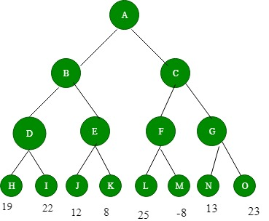
Figure 1: Before backing-up of values

Slide 8
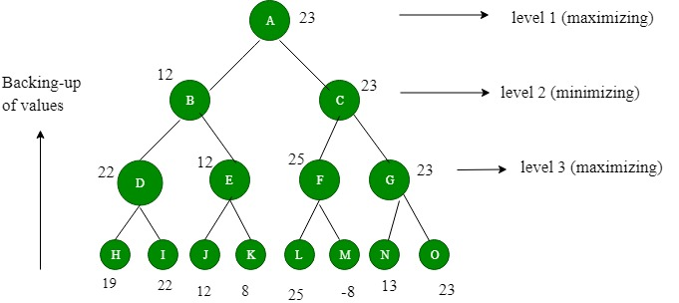
Figure 2: After backing-up of values We assume that PLAYER1 will start the game

Slide 9
Game start – PLAYER1 begins the game.
Game tree depth – The algorithm builds a 4-level game tree showing possible moves.
Leaf values – Nodes H, I, J, K, L, M, N, O get their scores from the STATICEVALUATION function.
Level 3 (Max level) – Each node here picks the maximum value from its child nodes (PLAYER1’s turn).
Level 2 (Min level) – Each node here picks the minimum value from its child nodes (opponent’s turn).
Value at root (A) – After backing up values through the tree, node A gets the score 23.
Best move – Since 23 is highest via move C, PLAYER1 should choose C to maximize winning chances.

Slide 10
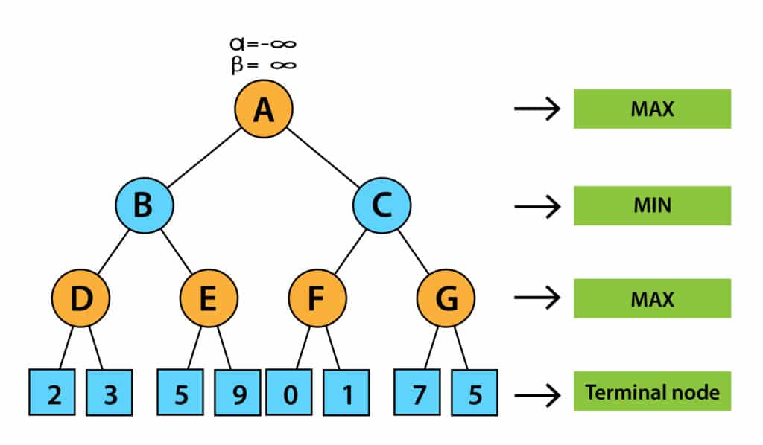
alpha-beta pruning
Working of Alpha-beta Pruning

Slide 11
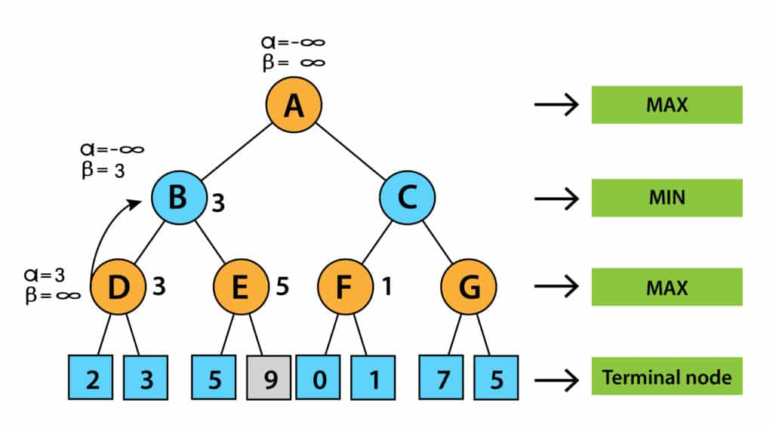

Slide 12
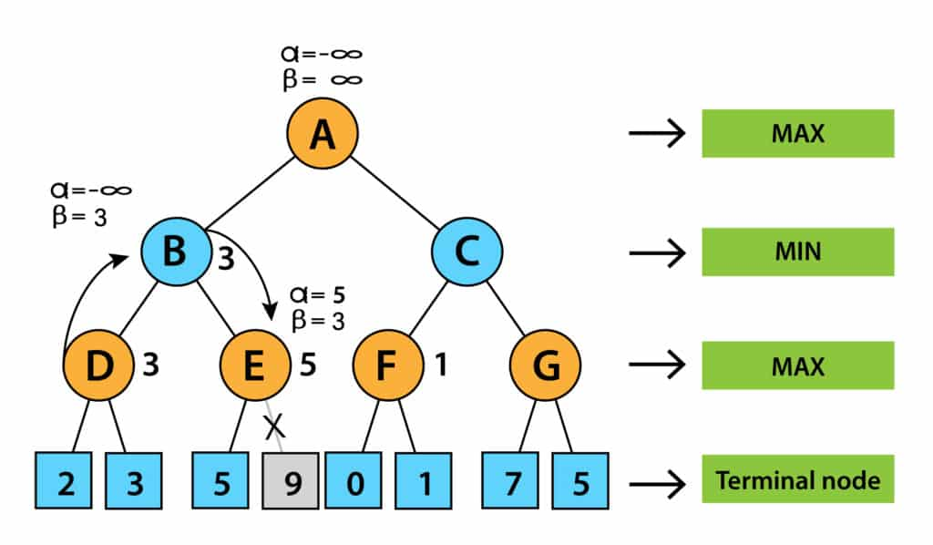

Slide 13
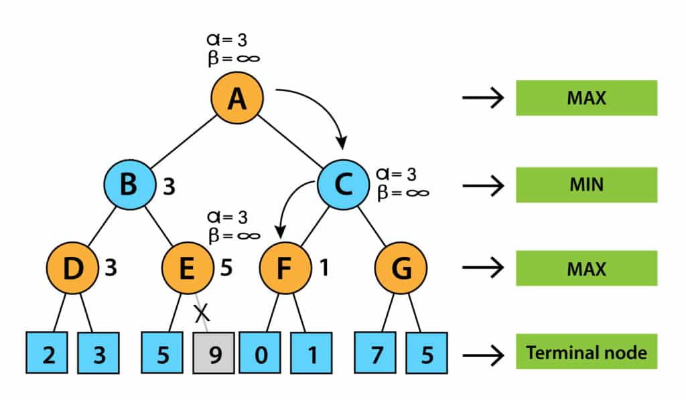

Slide 14
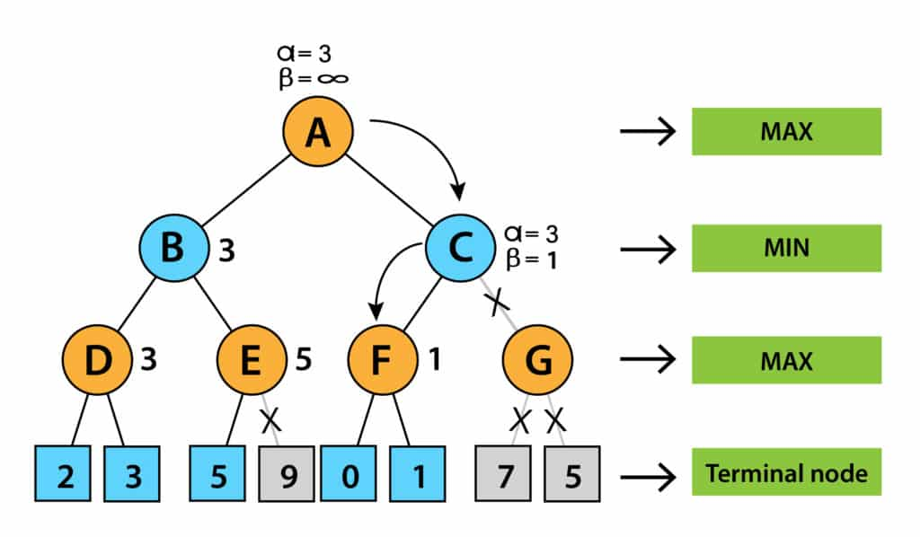

Slide 15
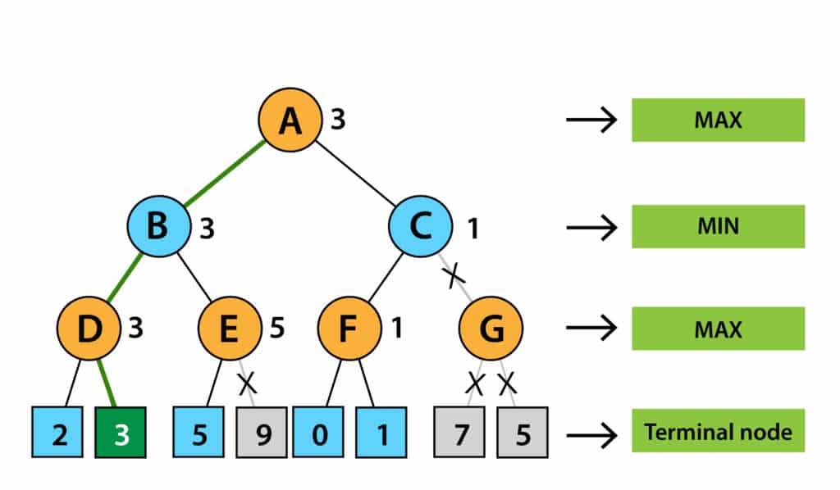

Slide 16
A = root (MAX)
B, C = children of A (MIN)
D, E = children of B (MAX)
F, G = children of C (MAX)
Leaves: 2, 3, 5, 9, 0, 1, 7, 5 (terminal values)
α = best (highest) for MAX so far;
β = best (lowest) for MIN so far.
Pruned branches marked (pruned).

Slide 17
Step-by-step
Initialize at root A:
α = −∞, β = +∞. A is a MAX node.
Go to A → B (MIN).
Pass down α = −∞, β = +∞.
Visit B → D (MAX).
  D’s leaves: 2, then 3.
  MAX at D: max(2,3) = 3.
  So D = 3. Return 3 to B.
Back at B (MIN):
  B updates β = min(+∞, 3) = 3.
  For B’s next child E we pass α = −∞, β = 3 (note β = 3 is now an upper bound MIN can force).
Visit B → E (MAX).
  E’s left leaf = 5 → E’s α becomes max(−∞, 5) = 5.
  Compare E’s α (5) with B’s β (3). Since α (5) ≥ β (3), E’s other child (9) is pruned
  — MIN above already has a cheaper option (3), so exploring E further cannot make MIN prefer E.
  So E = 5 (right child 9 not evaluated).
Finish at B:
  B has values {D=3, E=5} → B = min(3,5) = 3.
  Return 3 to A. Now A updates α = max(−∞, 3) = 3.

Slide 18
6. Go to A → C (MIN) with α = 3, β = +∞.
7. Visit C → F (MAX).
F’s leaves 0 then 1 → F = max(0,1) = 1.
Return 1 to C. Now C updates β = min(+∞, 1) = 1.
8. Prune at C:
At this point A’s α is 3 (MAX already can guarantee 3). At C we have β = 1. Since α (3) ≥ β (1), the remaining child of C (node G with leaves 7 and 5) is pruned — no need to evaluate G’s subtree because MIN will prefer the smaller value 1 and cannot make C’s value >= 3.
So G (7,5) not evaluated.
9. Finish at A:
C’s value = 1 (from F). A has {B=3, C=1} → A = max(3,1) = 3.
Best action for MAX: go to B (value 3). Final result = 3.

Slide 19
A (MAX) α start = -∞
├─ B (MIN) ← evaluated
│ ├─ D (MAX) -> leaves: 2, 3 => D = 3
│ └─ E (MAX) -> leaves: 5, 9 => E = 5 (9 pruned)
└─ C (MIN) ← evaluated
├─ F (MAX) -> leaves: 0, 1 => F = 1
└─ G (MAX) -> leaves: 7, 5 => (pruned entirely)
Pruned leaves: the 9 under E and both 7 and 5 under G.
Key takeaways
α/β track best guarantees for MAX and MIN as you search.
When α ≥ β at any point, prune: further exploration there can’t change the final decision.
Pruning saves evaluation of whole sub trees (faster search), while keeping the final answer exact (no approximation).

